Slide 1
Cluster Analysis

Slide 2
Contents
Why Segment Customers
Introduction to Clustering
Clustering
Clustering with Continuous Variables
Clustering with Categorical Variables
Clustering Checks
Comparing Clustering with other techniques

Slide 3
Contents
Why Segment Customers
Introduction to Clustering
Clustering
Clustering with Continuous Variables
Clustering with Categorical Variables
Clustering Checks
Comparing Clustering with other techniques

Slide 4
Why Segment?
Because customers are different
  A well developed and implemented segmentation can help the business in many ways:
    Understanding who your customers are
    Which are most profitable
    Opportunities / threats to particular customer groups
    Identifying business and customer changes over time
    Understand customer needs
Focus resources rather than mass marketing to the ‘average customer’

Slide 5
What makes a good segmentation?
Segments must be identifiable
  You must be able to allocate your customers into segments with ease from the data
Segments must be viable
  Unless the size and value of a segment deserves your attention, there is little point in having one
Segments must be distinctive
  There must be characteristics that make the segment stand out from the others
Segments must be actionable
  It is important that effective and manageable programs can be developed for attracting and servicing the segments
Segments must be understood
  By you; by your colleagues; by the business as a whole. Segmentation comes alive when it becomes the way marketing is reported to the business

Slide 6
Segmentation types
Attitudinal
Segment customers based on their underlying attitudes and aspirations
Needs Based
Segment customers based on customer needs, derived from attitudinal or behavioural data
Behaviour Based
Segment customers by behavioural characteristics, may include transactional data such as product usage, channel usage, relationship & payment methods
Demographic
Segment customers based on age, income, gender, life stage and other similar measurable characteristics
Value
Segment customers based on current or potential value, or a combination of the two
Segments customers based on geographic boundaries, useful when attempting to drive footfall to the store and for location planning
Geographic
Notes:
Segmentation strategies can be built in isolation or combination using an integrated dataset or by overlaying one onto another

Slide 7
Structure to build a Segmentation
1. Business Requirements analysis
2. Data Audit
3. Statistical
Analysis
4. Customer Segments
Reasons for development
Potential uses
Measures of success
e.g. Means clustering
5. Basic profiles
6. Will it satisfy all requirements?
No
Yes
9. Release to the business
8. Add information to the Database
7. Detailed Profiles

Slide 8
How we build a Segmentation
There are two main ways that we would look to segment customers
  Rules based approach
  Clustering
Today we will be looking at clustering

Slide 9
Contents
Why Segment Customers
Introduction to Clustering
Clustering
Clustering with Continuous Variables
Clustering with Categorical Variables
Clustering Checks
Comparing Clustering with other techniques

Slide 10
Background
Cluster Analysis is a multivariate (Independent) data analysis technique
Cluster Analysis examines an entire set of independent relationships
Cluster Analysis is a classification technique and ideally used in segmentation applications
Cluster Analysis is the collection of different algorithms and methods for grouping objects of similar kind into respective categories
Cluster Analysis can also called classification analysis or numerical taxonomy

Slide 11
Cluster Analysis – General overview
The primary objective of Cluster Analysis is to classify objects into relatively homogeneous groups based on the set of variables considered
Cluster Analysis aims at sorting different objects into groups in a way that the degree of association between two objects is minimal if they belong to the same group and maximal otherwise
It is the technique used for combining observations into groups or clusters
Observations in each cluster are homogeneous and out of cluster its is heterogeneous
Example: In food stores items of similar nature, such as different types of meet or vegetables are displayed in the same or near by locations
i.e. Cluster Analysis can be used to discover structures in data without providing an explanation or interpretation

Slide 12
Contents
Why Segment Customers
Introduction to Clustering
Clustering
Clustering with Continuous Variables
Clustering with Categorical Variables
Clustering Checks
Comparing Clustering with other techniques

Slide 13
Structure of Clustering
Clustering Procedures
Hierarchical
Non-Hierarchical
Agglomerative
Divisive
Sequential Threshold
Parallel Threshold
Optimizing Partitioning
Linkage Methods
Variance Methods
Centroid Methods
Ward’s Method
Single Linkage
Complete Linkage
Average Linkage

Slide 14
Approaches to Clustering
There are two ways to approach clustering
Hierarchical clustering or Linkage method
Non-Hierarchical clustering or Disjoint clustering or Nodal method or
K-means clustering or Quick clustering

Slide 15
Clustering - Hierarchical
Hierarchical clustering is primarily used when the number of observations are relatively small
In hierarchical clustering we don’t have to specify in advance how many clusters are to be extracted
It combines observations based on the distance
It works best on continuous data (mainly Interval data)

Slide 16
Structure of Hierarchical
Hierarchical
Agglomerative
Divisive
Linkage Methods
Variance Methods
Centroid Methods
Ward’s Method
Single Linkage
Complete Linkage
Average Linkage

Slide 17
Linkage models of Clustering
Single Linkage
Minimum distance
Complete Linkage
Maximum distance
Average Linkage
Average distance

Slide 18
Other agglomerative Clustering methods
Ward’s method
Centroid method

Slide 19
What's the difference? Hierarchical Clustering
1
2
Distances: up to
x x x x
x x x
x
x x x x x
x x x x x
x x x x x
x x x x
Data
x x x x
x x x
x
x x x x x
x x x x x
x x x x x
x x x x
Weight
Weight
Height
Height
3
Distances: up to
x x x x
x x x
x
x x x x x
x x x x x
x x x x x
x x x x
Weight
Previous clustering
Height

Slide 20
Syntax - Hierarchical
PROC CLUSTER DATA = DATASET METHOD = CCC PSEUDO
OUTTREE = DATASET_TREE;
VAR VARIABLES-LIST;
ID VARIABLE;
RUN;
Method - single/average/wards/two stage…..etc
ccc – Cubic clustering criterion
Pseudo – It displays F and t statistics. Used when the methods are average/ Centroid/ wards.
ID – It is required when NHCA is applied before HCA
Outtree – Output dataset

Slide 21
Clustering - Non Hierarchical
Non-Hierarchical clustering is used when the number of observations is relatively large
We have to specify the number clusters in an advance
Assigns observations to clusters iteratively
Seeks to minimize differences within clusters and maximize differences between clusters
Improves on this solution by iteratively re-assigning observations to clusters

Slide 22
Structure of Non-Hierarchical
Non-Hierarchical
Sequential Threshold
Parallel Threshold
Optimizing Partitioning

Slide 23
What's the difference? Non-Hierarchical
1
2
x x x x
x x x
x
x x x x x
x x x x x
x x x x x
x x x x
x x x x
x x x
x
x x x x x
x x x x x
x x x x x
x x x x
Data
o
Seeds
o
Weight
Weight
o
o
3
Height
4
Height
x x x x
x x x
x
x x x x x
x x x x x
x x x x x
x x x x
x x x x
x x x
x
x x x x x
x x x x x
x x x x x
x x x x
o
o
o
o
o
o
Move the Seeds
Weight
Weight
o
o
o
o
o
o
Height
Height

Slide 24
What's the difference? Non-Hierarchical
Recalculate the distance
4
x x x x
x x x
x
x x x x x
x x x x x
x x x x x
x x x x
o o o o
Weight
Height

Slide 25
Syntax – Non Hierarchical
PROC FASTCLUS DATA = DATASET
MAXITER = n
MAXCLUSTERS = n
DELETE = n
OUTSEED = DATASET_H (rename=cluster=))
OUT = DATASET_FAST;
VAR VARIABLE-LIST;
RUN;
Maxiter - Number of iterations through the clustering process
Maxclusters - start with this number of cluster seeds
Delete - Prevent clusters from forming which have no more than this many observations.
Outseed - The seeds after the last iteration (this will go into the hierarchical clustering)
Out - Same as input data with cluster and distance to its centre appended.
The renames are because another variable called cluster is produced later

Slide 26
Difference between HCA & NHCA
We don’t have to specify in an advance how many clusters are to be extracted.
It will work on small data sets
Data type – Interval scaled
Rare cases – categorical data
Proc cluster
We have to specify in an advance how many clusters are required
It will work on large data sets
Data type – Interval scaled
Rare cases – categorical data
Proc fastclus
Hierarchical Clustering
Non-Hierarchical Clustering

Slide 27
So which Technique Should I Use?
Use both the techniques vice-versa for all kinds of data
proc fastclus
proc cluster
Customer Database
A ‘moderately large’ number of clusters
A ‘manageable number’ of segments
‘3 to 20’ clusters
10,000+ observations
‘3 to 20’ clusters
10,000+ observations
‘10 to 100’ sub-clusters
‘10 to 100’ sub-clusters
proc cluster
proc fastclus
Customer Database
A ‘moderately good’ number of clusters
A ‘manageable number’ of segments
1000 observations
‘5 to 10’ sub-clusters
‘5 to 10’ clusters

Slide 28
Formulate the problem
Formulate the problem
Select a distance measure
Select a clustering procedure
Decide on the number of clusters
Interpret and profile clusters
Access the validity of clustering

Slide 29
Contents
Why Segment Customers
Introduction to Clustering
Clustering
Clustering with Continuous Variables
Clustering with Categorical Variables
Clustering Checks
Comparing Clustering with other techniques

Slide 30
Standardise Data
It is advisable standardise variables before performing clustering.
  This is so that variables with a large variation do not dominate
  Ensures that all variables are measured on an identical scale
proc standard data = cluster.fozzy_metrics_12feb
mean = 0 std = 1
out = fozzy_metrics_std;
var &vars;
run;
By capping the standardized data you can eliminate outliers

Slide 31
Disjoint Clustering – Proc fastclus
proc fastclus data = fozzy_metrics_std
maxiter = 100
maxclusters = 100
delete = 1000
outseed = fastmean (rename = (cluster = disj))
out = fastout (rename = (cluster = disj));
var &vars;
run;
Base this on your sample size
maxiter number of iterations through the clustering process.
maxclusters start with this number of cluster seeds.
delete prevent clusters from forming which have no more than this many observations.
outseed the seeds after the last iteration (this will go into the hierarchical clustering)
out same as input data with cluster and distance to its centre appended.
The renames are because another variable called cluster is produced later.

Slide 32
Disjoint Clustering – What to look for in the log
NOTE: Convergence criterion is satisfied.
  This means the clustering has finished before the number of maxiter has been used
WARNING: Iteration limit reached without convergence.
  This means the maxiter option is not large enough.

Slide 33
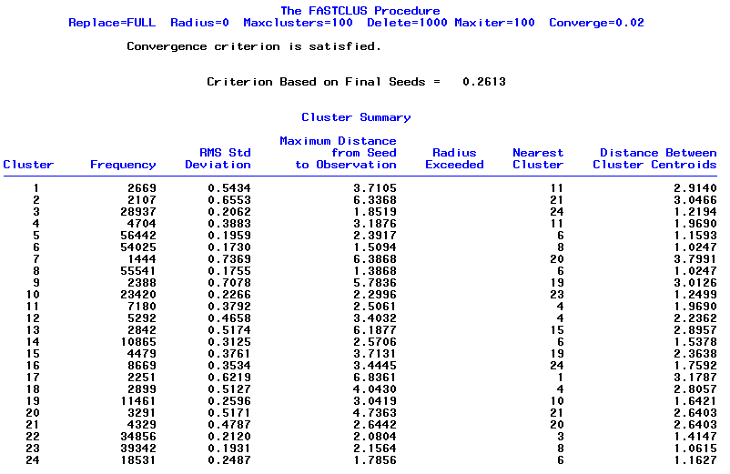
Disjoint Clustering – What to look for in the Output
24 Clusters have been produced
Size of each cluster
Variability within each cluster. Small = tight cluster
Distance from nearest cluster.
Large = distinctive cluster

Slide 34
Disjoint Clustering – What to look for in the Output
Statistics for Variables
Variable Total STD Within STD R-Square RSQ/(1-RSQ)
avg_spend_per_wk 1.00000 0.18064 0.967373 29.649072
avg_spend_per_wk_shopped 1.00000 0.23267 0.945866 17.472714
avg_visits_per_wk 1.00000 0.22946 0.947350 17.993518
avg_visits_per_wk_shopped 1.00000 0.34133 0.883499 7.583586
days_since_last_visit 1.00000 0.31880 0.898374 8.840001
no_visits 1.00000 0.22946 0.947350 17.993518
total_spend 1.00000 0.18064 0.967373 29.649072
weeks_shopped 1.00000 0.32130 0.896770 8.687097
OVER-ALL 1.00000 0.26127 0.931744 13.650798
A large difference here signifies a good variable
A large number here signifies a good variable
If a variable has a small R-square value (under 0.25), then it is not contributing a lot to the clustering. Considering re-running the clustering excluding it.
Output is also produced about the cluster means (the mean of each variable in each cluster). This can be used to attach a meaning to each segment (e.g. high value, high number of visits and low spend).

Slide 35
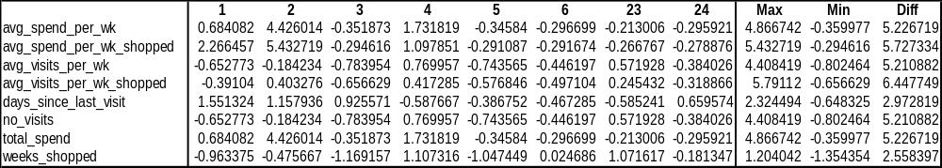
Disjoint Clustering – What to look for in the Output
Export the cluster means, to look at them in excel
  See if a variable is contributing
  Have an initial look at the clusters
A small number here signifies variable that is not contributing much

Slide 36
Hierarchical Clustering – Proc cluster
proc cluster data = fastmean method = ward ccc
outtree = clus_tree;
var &vars;
id disj;
run;
This will take the 24 final seeds output from the disjoint clustering and join them together.
Various methods are available. Ward uses a ‘minimum variance criterion’
ccc stands for cubic clustering criterion
id disj ensures the original 24 level clustering is carried forward

Slide 37
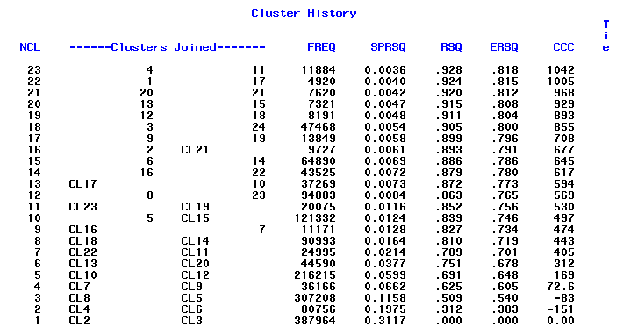
Hierarchical Clustering – What to look for in the Output
The most similar clusters are 4 and 11. These are joined to form a cluster called CL23. The next most similar clusters are 1 and 17 etc. Use proc tree to produce a diagram
FREQ: size of the cluster formed by joining these two.
SPRSQ: semi-partial R-squared. A jump in these values (e.g. ) gives a good place to define the final segments. We will have 12 clusters and 24 sub-clusters

Slide 38
Print a ‘hierarch’ to ‘disj’ lookup
Lower level clusters
Top level clusters
proc tree data = clus_tree
nclusters = 12
out = hierclus (rename = (
cluster = hierarch));
id disj;
run;
proc sort data = hierclus;
by disj;
run;
proc print data = hierclus noobs;
var disj hierarch;
run;
Because we wish to create 12 top level clusters (see previous slide)
disj hierarch
1 2
2 3
3 6
4 1
5 11
6 8
7 12
8 10
9 7
10 7
11 1
12 5
13 4
14 8
15 4
16 9
17 2
18 5
19 7
20 3
21 3
22 9
23 10
24 6

Slide 39
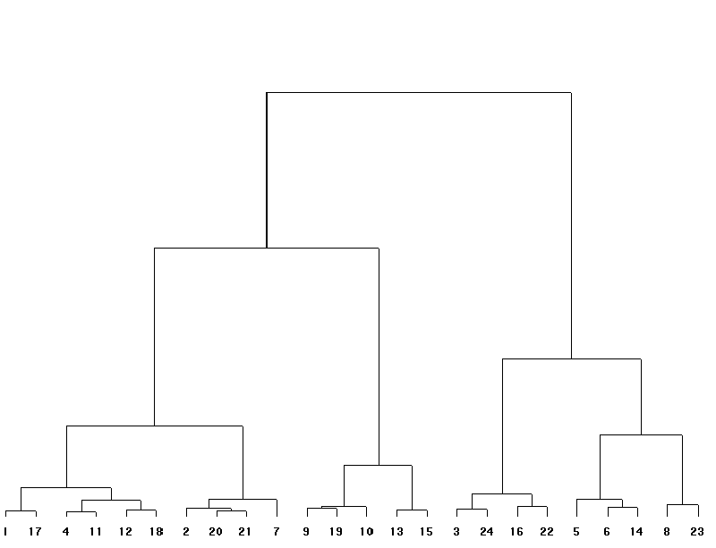
Output from Proc Tree
1
2
3
4
5
6
7
8
9
10
11
12

Slide 40
Merge the two clustering and produce a summary
proc sort data = fastout;
by disj;
run;
data fastout_hierclus;
merge fastout hierclus;
by disj;
run;
proc means nway data = fastout_hierclus;
class hierarch;
var &vars;
output out = summary (drop = _type_ rename = (_freq_ = count)) mean =/autoname;
proc print;
run;
This has produced a 11 level clustering with a 24 level sub-clustering
Export the output to Excel for investigation

Slide 41
Contents
Why Segment Customers
Introduction to Clustering
Clustering
Clustering with Continuous Variables
Clustering with Categorical Variables
Clustering Checks
Comparing Clustering with other techniques

Slide 42
Categorical variables: the process
UPC Gender Marital_status
0003 M Single
0004 M Divorced
0007 F Widowed
0011 M Single
0012 F Single
UPC Gender_M Gender_F Single Divorced Widowed
0003 1 0 1 0 0
0004 1 0 0 1 0
0007 0 1 0 0 1
0011 1 0 1 0 0
0012 0 1 1 0 0
UPC fact1 fact2 fact3 fact4 fact5
0003 0.910 0.561 0.210 -1.89 0.000
0004 0.216 0.005 0.888 -0.12 0.004
0007 -1.25 0.239 0.565 -0.23 0.464
0011 0.005 0.569 1.260 -0.05 1.621
0012 0.230 -0.05 0.430 1.374 0.801
Urn cluster
0003 1
0004 3
0007 2
0011 1
0012 4
Categorical data
proc GLMMOD
Data with lots of correlated dummy variables
proc factor
NOTE: Factor analysis needs to be combined with non-binary variables
Data with fewer, uncorrelated, numerical variables called factors
Cluster analysis

Slide 43
Contents
Why Segment Customers
Introduction to Clustering
Clustering
Clustering with Continuous Variables
Clustering with Categorical Variables
Clustering Checks
Comparing Clustering with other techniques

Slide 44
Clustering checks
Before a clustering solution can be decided upon a number of checks need to be carried out
Robustness
  Any solution developed needs to be robust. That is, if the same process were developed on a different sample or for a different time period the same segments would be detected.
Stability
  Once a solution has been chosen it is important that when refreshed in the next period, not many customers change segments
Relevance
  Any solution needs to be relevant to the business

Slide 45
Clustering checks - Robustness
To check for robustness
  Run clustering solution with many different initial seeds
    Check that similar clusters appear
  Run clustering solution over different samples of data
    Check that similar clusters appear
  Run clustering solution over a different time period
    Check that similar clusters appear
A macro for these tests can be created (bootstrapping)

Slide 46
Clustering checks - Stability
This looks at stability over time
Using exactly the same solution (including initial seeds) run the solution over a different time period
  Check that the proportion of customers in each segment is similar
  Check the movement of customers between segments
    Cross-tab of customers in both groups
    Illustrate using a perceptual map, e.g. correspondence analysis (PROC CORRESP )

Slide 47
Clustering checks - Relevance
This will be achieved by conducting regular review sessions with the business to understand if the output would be applicable to their business needs

Slide 48
Contents
Why Segment Customers
Introduction to Clustering
Clustering
Clustering with Continuous Variables
Clustering with Categorical Variables
Clustering Checks
Comparing Clustering with other techniques

Slide 49
Clustering with other techniques
Cluster Analysis contrasts sharply with ANOVA, Regression, Discriminant Analysis, and Factor Analysis, which are based upon an extensive body of statistical reasoning
Both Cluster and Discriminant analysis are classification techniques
If the market segments are unknown, use Cluster analysis
If the market segments are known but a firm needs to classify new customers into those segments, use Discriminant analysis
Cluster analysis not requires any prior information of the cluster
Discriminant analysis requires prior knowledge of the clusters
Factor analysis is used to combining the variables
Cluster analysis is used to combining the observations

